Slide 1
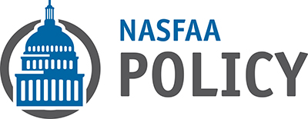
NASFAA Federal Update
Megan McClean
1

Slide 2
Agenda
Washington Political Climate
Federal Budget and Funding Update
Reauthorization Preview
NASFAA Influence
Other Policy Updates:
Status of Perkins
Update on Recent Negotiated Rulemaking
Student Aid Bill of Rights
Get Involved!

Slide 3
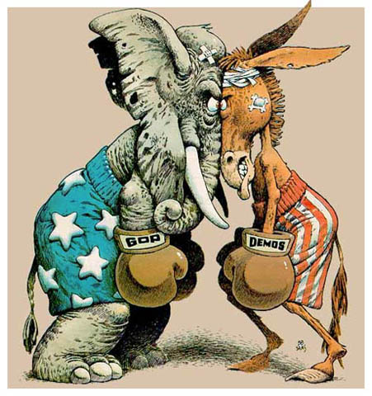
Washington Political Climate

Slide 4
Washington Political Climate
Partisanship, Brinkmanship, and “Blame Game”
Deficit Reduction
Budget Politics Dictating Policy
2016 Election! (Already? Sigh.)

Slide 5
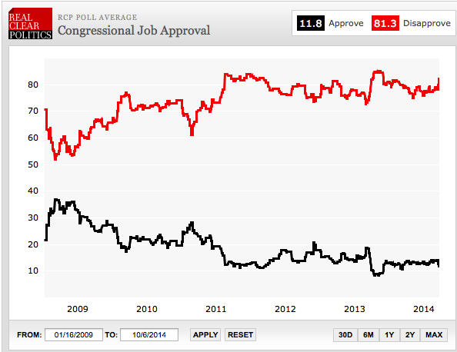
Congressional Approval Numbers

Slide 6
Impact of the Election
New Congress (114th) began Monday January 5th
Republican control of both chambers
Major changes on the education committees:
Senate: New HELP chairman
Sen. Alexander (R-TN)
Sen. Tom Harkin (D-IA) retired
House: Rep. Kline (R-MN) remains chair
Received a waiver to do so
Rep. Miller (D-CA) retired, Rep. Scott (D-VA) ascends to ranking member

Slide 7
A Republican Congress & Higher Ed
Sen. Alexander’s HELP Committee
Focus on simplifying FAFSA and student aid
Eye on innovative higher ed models
Tough battles over funding
New investments in student aid unlikely
Simplification should not equate to cuts
Action towards burdensome regulations
Roadblocks for college rating system

Slide 8

Federal Budget & Funding Update

Slide 9
Budget and Appropriations 101
What should happen:
President delivers Budget Request to Congress in early Feb.
House and Senate each draft a Budget Resolution
Each of 12 Appropriations Subcommittees draft bills
The completed bills are passed by Oct. 1
But… Congress rarely follows this process:
Politics jam the gears, no punishment for not following order
Instead we more often than not see mechanisms that help to patch the inability to pass separate appropriation bills
Continuing Resolution (CR)
Omnibus
Notes:
Can talk here about the fact that aside from this past year, for example, Senate hasn’t passed budget resolution in years
Normal approps process hasn’t occurred in years as well
Past several years have been ultimately funded by CRs or omnibuses
Does not allow for committee experts to thoughtfully and carefully debate spending levels for the issues they are most well versed in—cuts against democratic process

Slide 10
Student Aid and the Budget
Funding for student aid falls into the Labor, Health, Human Services, and Education Appropriations Subcommittee (Labor-H)
This is always a very complex bill because so many important programs share the same pot of funds
Most student aid funds are “forward funded” meaning they fund the following award year
Ex: FY 2016 funds the 2016–17 award year
Notes:
- Its kind of crazy to think about how important we know our programs are and how they have to compete with programs in health and labor (two other very important areas)

Slide 11
Budget Update: FY 2015
Finalized in December 2014:
The “Cromnibus”
Provides funding for 2015-16 award year
Pell Grant fully funded
Max award expected to be $5,775
Less than expected due to Consumer Price Index
Level funding for SEOG
Small increase for FWS
Partial restoration of Ability-to-Benefit

Slide 12
FY 2015 – Big Picture

Slide 13
Is Sequestration Still In Effect?
Sequestration is still in effect - it is a cutting mechanism meant to cut roughly $1 trillion dollars over a decade
In order for sequestration to be stopped, Congress must pass a bill to either repeal or replace the law
Appetite is more toward replacement rather than repealing, but this is also the most difficult of options as it requires Congress to come to an agreement in other areas

Slide 14
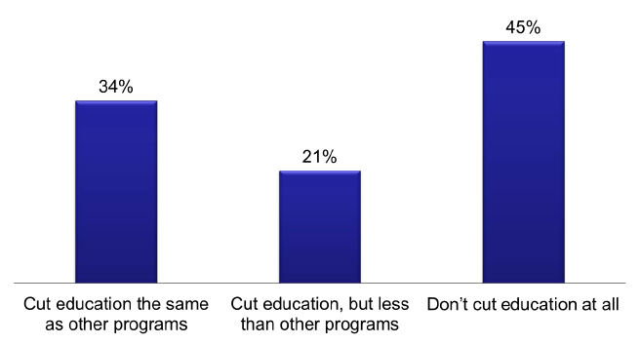
Public Attitude Toward Sequestration
Two-thirds want to protect education from sequester cuts
Source: CEF/FEI Poll, December 2012

Slide 15
Future Funding Outlook: More Cliffs!
Debt Ceiling reinstatement & subsequent expiration
(3/15 & Fall)
Congress must pass FY 16 budget by new fiscal year
(10/1)
CR Funding Department of Homeland Security (Deal struck on 3/3)

Slide 16
Obama FY16 Budget Request (AY 2016-17)
Grants
Maximum Pell Grant of $5,915
Continue to index Pell to inflation beyond FY17
Campus-Based Aid
Level fund FSEOG and FWS (FY 2015 levels)
Revise allocation formula to direct dollars to schools that enroll and graduate high number of Pell Grant students
Expand/Reform the Perkins Loan Program

Slide 17
Obama FY16 Budget Request
Tax Provisions
Consolidate and permanently extend American Opportunity Tax Credit (AOTC)
Increase refundable portion to $1,500
Simplify tax credits for most Pell recipients by clarifying and simplifying the AOTC rules
Provide tax relief for student loan borrowers by exempting amounts of debt forgiven under income-dependent plans

Slide 18
Obama FY16 Budget Request
Loans
Expand Paye As You Earn eligibility to all borrowers
Pay for this expansion by making modifications to PSLF
Access and Affordability Proposals
America’s College Promise ($60 billion/10 yrs)
College Opportunity Bonus Program ($7 billion/10 years)
Rewards colleges that enroll and graduate low-income students and encourage all colleges to improve
Notes:
Using total household income for all married couples when calculating income-driven monthly payments.
Extending the PAYE repayment term to 25 years before forgiveness for borrowers with federal student loan debt that is greater than the aggregate, independent, undergraduate loan limit (currently $57,500).
Eliminating the current payment cap that limits monthly payments to the monthly payment under 10-year standard repayment based on original loan balance.
Capping the amount of interest that can accrue when a borrower’s monthly payment is insufficient to cover the interest to avoid ballooning loan balances.
Capping the amount forgiven under the Public Service Loan Forgiveness (PSLF) Program to the aggregate, independent undergraduate loan limit (currently $57,500) for all borrowers.
Limiting qualifying payments for PSLF to payments made in an income-driven repayment plan (i.e., no payments made while in the 10-year standard repayment plan would count).

Slide 19
GOP FY16 Budget Resolutions
Political documents, light on specific numbers
Freeze maximum Pell Grant for next 10 years
House seeks to address the shortfall “targeting it to students who need the most assistance”
Fair Value Accounting for student loans
$220+ billion cost increase over 10 years
Reconciliation instruction to find an additional $1 billion in savings over next 10 years
Threat to in-school interest subsidy?

Slide 20
GOP FY16 Budget Resolution
For nondefense discretionary spending (NDD), maintains the FY 2016 sequester cap
Hard to get any increases
Starting in FY 2017, the budget cuts NDD spending each year below the sequester level caps.
In total, cuts NDD by $759 billion over ten years, a 14 percent cut in the aggregate
Education programs have already had $80 billion cut from them since FY 2011
Even when saving have gone back to Pell, its robbing Peter to pay… Peter

Slide 21
House Proposes Cuts to Aid Programs
Eliminates mandatory funding for Pell
Cuts Pell by $89.3 billion
Eliminates in-school interest subsidy on loans
Cuts $34.8 billion by shifting costs to students
Eliminates public service loan forgiveness
Cuts $10.5 billion, again shifting costs to students
Eliminates the PAYE expansion
Cuts $16.3 billion
All told, $150 billion would be cut from student aid over 10 years

Slide 22
Senate Proposes Cuts to Aid Programs
Eliminates mandatory funding for Pell
Cuts Pell by $89.3 billion
Eliminates in-school interest subsidy on loans
Cuts $34.8 billion by shifting costs to students
All told, $124 billion would be cut from student aid over 10 years

Slide 23
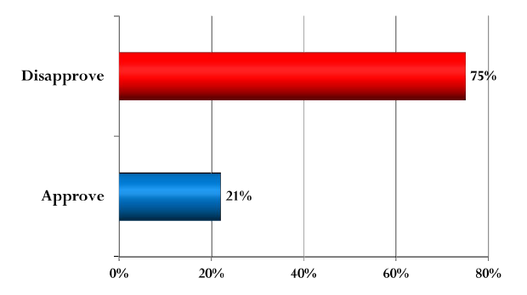
The Public Opposes Education Cuts
Would you approve or disapprove of reducing federal funding for education as a way to reduce the size of the national debt?
Source: Pew Research Center for the People & the Press, October, 2012

Slide 24
Senate Student Aid-Related Amendments
Amendment to restore Year-Round Pell: Sens. Susan Collins (R-ME) and Maize Hirono (D-HI)
Amendment to simplify and streamline the repayment plans: Sen. Richard Burr (R-NC)
Both are policy positions for which NASFAA has been advocating!
Funding comes from “deficit neutral reserve fund”: A term of art that means lawmakers support a policy proposal but don’t currently have a clear path to funding and implementing it

Slide 25
Fair Value Scoring
Fair-value scoring builds in certain market risk penalties that ultimately result in higher cost estimates for federal credit programs
Adding these ‘phantom costs’ to the scoring model will make the process less accurate, less comparable, and less transparent.
Revenue of $135 billion vs. “cost” of $88 billion
Why does it matter?
Higher costs of borrowing, and reduced benefits
Will cost avg. student $3,800, increase student debt by 15%
Notes:
But valuing federal credit programs like the market would value them at ignores fundamental sector differences
The federal government does not perceive or value risk the same way as a private lender would, nor should it.
The current scoring method has been accurate within 1% over the last decade
Increased deficits with no changes to underlying programs

Slide 26
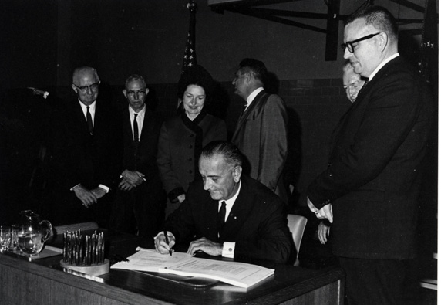
Reauthorization

Slide 27
Reauthorization
Higher Education Act reauthorization should occur in 2015; but that likely will not happen
The process has started, will continue, but there will not be a final bill
NASFAA's Reauthorization Task Force submitted recommendations to House and Senate Ed Committees
Predictions on timing
An automatic one-year extension was granted at end of 2014
Initial legislation has been released in both House and Senate, but markups didn’t happen
Maybe start to see real movement in spring/summer 2015

Slide 28
Steps to Higher Education Act Reauthorization
Hearings
Drafting Legislation
Marking Up Legislation
Passing Legislation
Reconciling Legislation
Signing Legislation

Slide 29
Three Main Efforts So Far
Bipartisan Senate bill from Sen. Alexander (R-TN) and Sen. Bennet (D-CO)
Democratic Senate bill at the end of the 113th Congress from outgoing chairman Sen. Harkin (D-IA)
Three bills from the House education committee that passed the full House last Congress

Slide 30
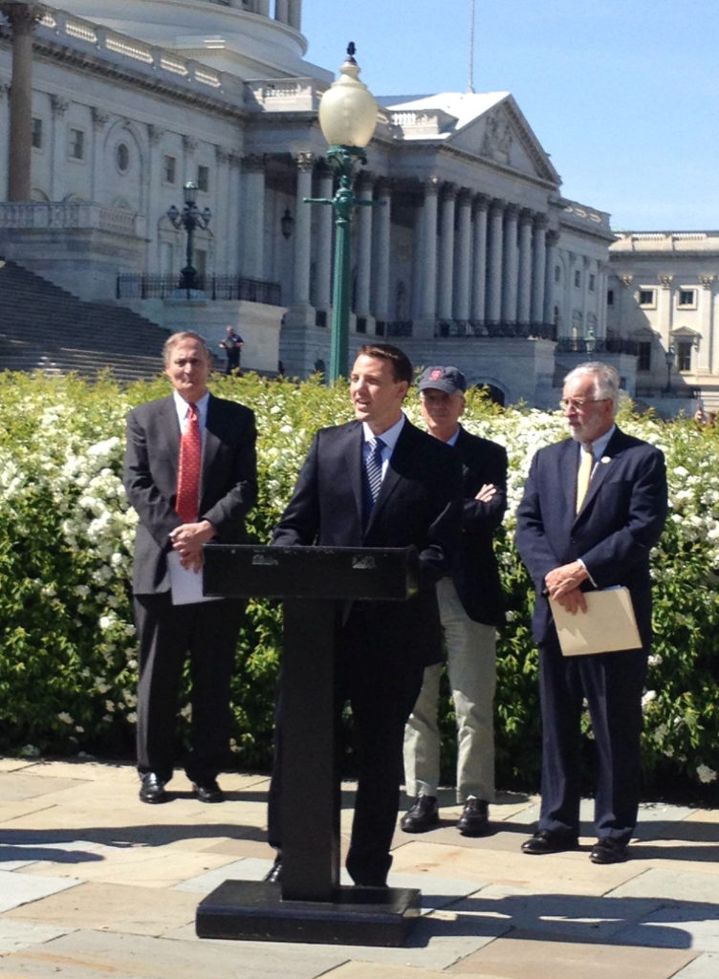
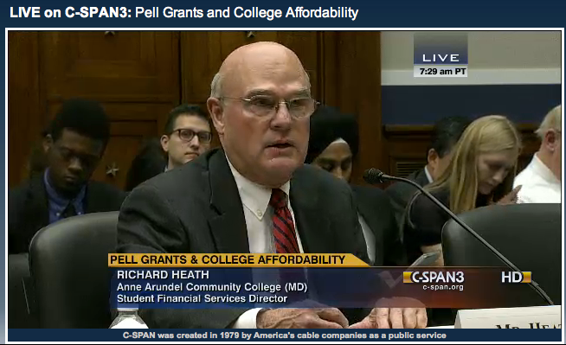
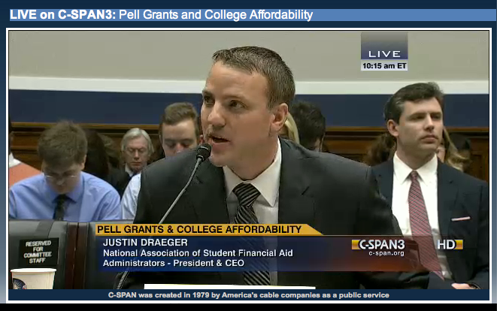
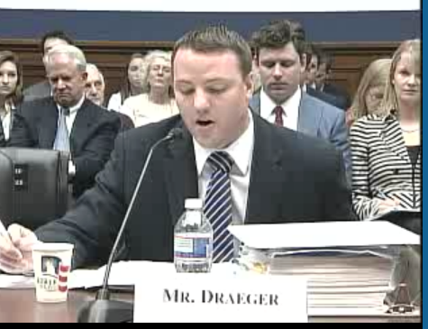
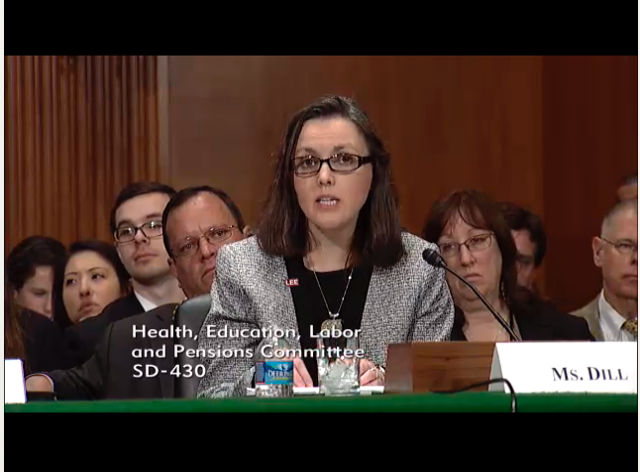
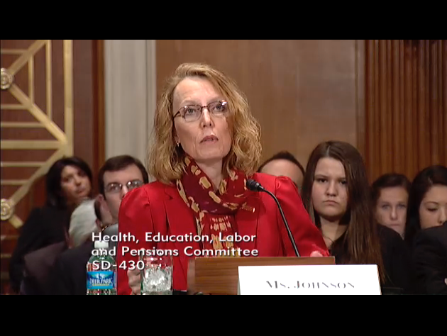
Influence on Legislation

Slide 31
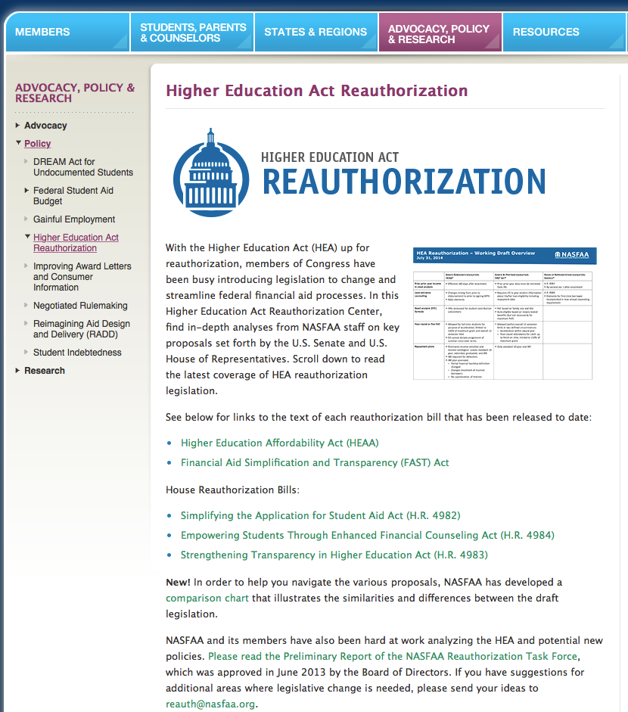
http://www.nasfaa.org/reauth/

Slide 32
Policy Task Forces
Past
Reauthorization Task Force
Reimagining Aid Design and Delivery (RADD) Task Force
Task Force on Student Loan Indebtedness
Task Force on Public Service Loan Forgiveness
Task Force on Campus-Based Allocations
Task Force on Consumer Information
Task Force on Loan Servicing
Existing
Task Force on Program Integrity Regulations
Task Force on R2T4
Task Force on Innovative Learning Models
Task Force on Benchmarking
Future
More to come!

Slide 33

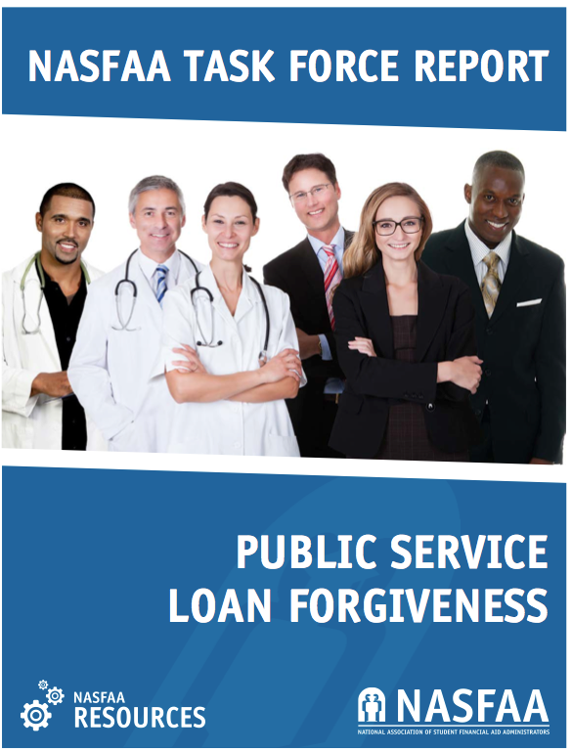

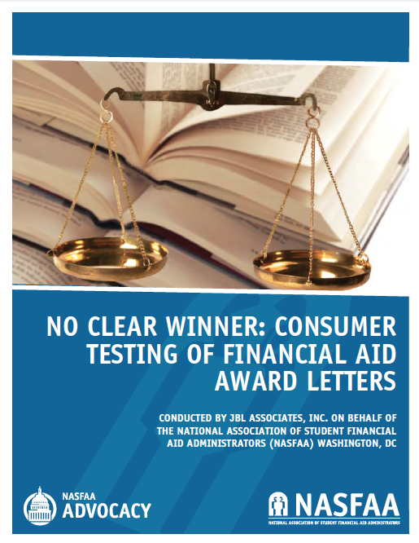
Notes:
Servicing Recs:
Information and communication
Standardization
Joint TF with DL Coalition
A report to be delivered to ED and other relevant agencies containing recommendations for improving federal student loan servicing, clearing indicating (1) areas of deficiency in loan servicing, (2) the extent (how widespread) of those deficiencies, and (2) proposed solutions
PSLF Recs:
Keep PSLF
Forgiveness of up to 100% of the independent, undergraduate aggregate Stafford loan limit (currently $57,500); and
50% of any remaining qualifying loan balance, up to a maximum forgiveness amount of the graduate aggregate Stafford loan limit (currently $138,500)
Consumer Info Recs:
Study the usefulness of consumer disclosures not related to Title IV aid and determine the most effective, and least burdensome, method of disclosure.
Eliminate the vague disclosure requirement to report the placement of, and types of employment obtained by, graduates of an institution's degree or certificate programs.
Establish that the online entrance counseling provided by ED constitutes a compliance “safe harbor.”
Use consistent metrics when presenting borrowing levels (ie. “median” vs. “average”).

Slide 34
Perkins?
Authorized through September 30, 2015
No Federal Capital Contribution (FCC) since FY 2005
No cancellation reimbursements since FY 2010
ED released stated that if schools make first disbursements prior to October 1, 2015, then they are allowed to make subsequent disbursements for the remainder of award year 2015-16
Early Feb. ED issued DCL GEN-15-03
Make loans to certain students through September 30, 2020 to enable students who received loans for award years that end prior to October 1, 2015 to complete their studies.
If Congress does not proactively act to keep the program, it will expire on September 30, 2016
Cost concerns fueling uncertainty
Notes:
The school made at least one Perkins loan disbursement to the student on or before June 30, 2015.
The student is enrolled at the same institution where the last Perkins Loan disbursement was received. For example, a student who received a Perkins Loan disbursement at School A, and then received a Perkins Loan disbursement at School B, would be considered to be an eligible grandfathered borrower at School B, provided all other conditions are met, but not for a subsequent enrollment at School A.
The student is enrolled in the same academic program for which the student received his or her last Perkins disbursement. ED considers an academic program to be the same program only if the first four digits of the program’s Classification of Instructional (CIP) code are identical to the first four digits of the CIP code for the program for which the student received his or her last Perkins Loan disbursement.
While the law provides for this limited “grandfathering” continued eligibility for Perkins Loans “as may be necessary to enable students…to continue or complete courses of study,” many of these grandfathered students could have their need met by a combination of other student aid and thus will not need a Perkins Loan to “enable [them]...to continue or complete [their] course of student.” Therefore, a Perkins Loan can be made to an otherwise eligible grandfathered student to meet all or some of the student’s unmet need only after the student has been awarded all Direct Subsidized Loan aid for which the student is eligible.
The DCL reinforces that the grandfathering provision only applies to students who have received Perkins Loans for award year 2014-2015 or earlier, so students who receive their first Perkins Loan in the 2015-2016 award year will not be eligible for grandfathering.

Slide 35
Perkins?
Where does NASFAA stand on Perkins
Reauthorization Task Force (RTF) called for the continuance of Perkins, along with the other campus-based aid programs
Advocating for the program on Capitol Hill
If program ceases, NASFAA’s RTF offered the following recommendations:
Instruct the Secretary of Education to offset the amount of FCC to be returned to the federal government by the aggregate amount of unfunded reimbursement for cancellations
Ensure that institutional contributions made in excess of the minimum required or made when there was no new FCC are also offset so that the amount due to the federal government is not overestimated
Where does the Administration stand on Perkins?
Perkins reform proposal in budget request

Slide 36
Negotiated Rulemaking Update
PAYE
First session held 2/24 - 2/25
ED proposed PAYE2 and received significant pushback
Will consider five new proposals
“Warm transfer” from loan rehabilitation
Two technical changes
Lower rehabilitation collection fees from 18.5% to 16%
A provision regarding the sale of defaulted loans before rehabilitation
Participation rate index (PRI) appeals for cohort default rates (CDRs)
Lump sum payments from the Department of Defense (DoD)
Required PAYE renewal notifications to borrowers:
Next session 3/31 - 4/2
Notes:
1. “Warm transfer” from loan rehabilitation: Lenders and servicers would be able to share a borrower’s income documentation and family size information gathered during the loan rehabilitation process with a borrower’s new servicer after transitioning out of loan rehabilitation. This would allow borrowers with newly rehabilitated loans quicker access to income-driven repayment plans and hopefully prevent the borrower from defaulting again. Negotiators would also consider whether borrowers could continue to make the “reasonable and affordable” monthly payment established during the rehabilitation process for a certain period of time while they select a new repayment plan.
2. Technical changes: As noted by a negotiator representing legal assistance organizations that represent students, there are two items already in statute that are not currently included in the regulations: lowering rehabilitation collection fees from 18.5 percent to 16 percent, and a provision regarding the sale of defaulted loans before rehabilitation.
3. Participation rate index (PRI) appeals for cohort default rates (CDRs): NASFAA member Pat Hurley’s proposal would allow a school to appeal CDRs based on low participation rates before sanctions set in for the institution. NASFAA members on the committee noted that this change could encourage community colleges to continue participation in the federal student loan programs.
4. Lump sum payments from the Department of Defense (DoD): This proposal would count lump sum payments to servicemembers as separate qualifying payments for the purposes of various loan forgiveness programs. This change would treat lump sum payments from DoD in the same manner as those from Americorps and the Peace Corps.
5. Required PAYE renewal notifications to borrowers: Given that approximately 40 percent of borrowers enrolled in PAYE do not re-enroll in PAYE after the first year in a timely manner, negotiators will consider ways to improve the notification process.

Slide 37
CBO Updated Baseline
Updated 3/9, includes revisions to long-term outlooks for student loans and Pell
Loans
Projects a $27 billion (30%) increase in outlays for student loans for the 2016–2025 period.
Higher estimates of the number of loans in default and
Lower estimates of collections
Increases in the est. cost to administer the loan programs
Increased participation in repayment plans that are based on the income of borrowers.
Pell
Funding cliff moved one year further out
Shortfall starts in FY18, $2.3 billion
Total shortfall FY18-FY25 of $31.8 billion
Overall, deficit is projected to go down because of lower ACA costs

Slide 38
White House: Student Aid Bill of Rights
Announced March 10, 2015
Echoes work of NASFAA Servicing Issues Task Force
Key points:
Create a centralized portal in which borrowers could get information on, and pay down, their student loans.
Develop an online student aid complaint system
Notification to borrowers of transfer between servicers
Study multi-year IBR application
Apply prepayments to the loan with the highest interest rates
Two pilot studies on how borrowers receive information about servicing and how they choose repayment plans

Slide 39
Unusual Enrollment History
ED is expanding the unusual enrollment flag for 15-16
New factors:
Must review flagged students who received either Federal Pell Grants or Federal Direct Student Loans
Does not include Direct Consolidation Loan or Parent PLUS loans
Review period extended from prior three award years to prior four award year
Review and resolution process remains unchanged
For more information, see GEN-13-09 and GEN-15-05

Slide 40
You Can Advocate, Too!
Join a task force!
Write a letter!
Visit with your member of Congress, either locally, or in DC!
For more information, visit: www.nasfaa.org/take-action/ or email policy@nasfaa.org

Slide 41


